Slide 1
Chapter 08 Function
Dr. Le Thanh Sach

Slide 2
Content
What is function?
Reason to use function
The “main” function and library function
Using user defined functions
Definition
Function call
Principles of execution when calling a function
Function prototype, function signature, function overloading
Pass by parameters
Function and array, pointer
Inline function
Function pointer
Recursive function
Create a function library
Static links and dynamic links

Slide 3
What is function?
Function is
A processing unit
A group of statements that are related, executing together to perform a task
Example: In library <math.h>
Function sin(x)
A group of statements that compute the sine of an angle x, The angle x has the unit of radians; function sin(x) returns a real number
Function sqrt(x)
A group of statements that compute the square root of x, x is real-valued (float or double); function sqrt(x) returns a real number

Slide 4
What is function?
Function is
A processing unit
Get input value
Calculate
Return value
Illustration
Group of statements of function
Input values
Output values

Slide 5
What is function?
Illustration
Compute sin(x)
Input: x (radian)
Output: sin(x)
Compute sqrt(x)
Input: x (real)
Output: sqrt(x)

Slide 6
What is function?
Illustration for a function that adds two numbers
Input: Two real number a and b
Computation: Add two numbers
Output: Sum of two number
1. Compute sum of two number
2. Return the sum
Input:
a (real)
b (real)
Output: (a + b)

Slide 7
Reason to use function
Avoid duplicating source code
➔ Save development time
➔ Change the source code in the function quickly and easily, just in one place
Reuse a unit of calculation without having to rewrite it
Save development time
It is possible to share the unit of calculation not only for one project but for multiple projects
Example: Let’s consider the case that every project is rewriting the mathematical function: sin(x), sqrt(x), v.v. ➔ Costly and wasteful
➔ Use library <math.h>

Slide 8
Reason to use function
Help developing algorithms, organizing programs easily
Algorithm:
A fundamental technique for problem-solving: decompose a large problem into smaller sub-problems
➔ Each sub-problem can be a unit of calculation (as a function)
Example: Enter a sequence of numbers, calculate and print the mean and standard deviation of them. This problem can be decomposed into sub-problems
(1) Input a sequence of numbers
(2) Compute mean and standard deviation
(3) Print out the input numbers, mean and standard deviation

Slide 9
Reason to use function
Help developing algorithms, organizing programs easily
Algorithm:
Example: Enter a sequence of numbers, calculate and print the mean and standard deviation of them. This problem can be decomposed into sub-problems
(1) Input a sequence of numbers
(2) Compute mean and standard deviation
(3) Print out the input numbers, mean and standard deviation
➔ Each of the sub-problems above can be written as a function

Slide 10
Reason to use function
Help developing algorithms, organizing programs easily
Organize a program:
Comparing a program (written in C ++) to a book (English)
Is there any book in reality where the author writes the whole book into successive sentences; do not separate it into chapters, sections, subsections, paragraphs?
Functions have similar meaning as chapters or sections

Slide 11
The “main” function and library function
Return value: Type of int
Function name: “main”. A program must have and have only one main function
int main(){
// statements of the main function
return 0;
}
Returns the value to the caller of main
Return value of function “main”:
Must be int
May be one of two constants
EXIT_SUCCESS (or 0): If the program finishes successfully
EXIT_FAILURE (or 1): If the program ends with some errors

Slide 12
The “main” function and library function
If you want to pass arguments in the command line
arc: Number of arguments , including program name
argv: A list of strings, each string is an argument.
When passed in, all the data is interpreted as strings
#include <iostream>
using namespace std;
int main(int argc, char* argv[]){
cout << “Number of arguments: " << argc << endl;
for(int i=0; i < argc; i++)
cout << “Argument number " << i << ":" << argv[i] << endl;
return EXIT_SUCCESS;
}

Slide 13

The “main” function and library function
After compiling the program successfully, the file “Program.exe” is created
Run “Program.exe” in command line as follow:
Arguments for the program

Slide 14
The “main” function and library function
How to pass command line arguments in Visual Studio
(1) Right-click on the <project> in the "Solution Explorer"
(2) Choose “Debug” > “Command Arguments”
(3) Choose “Edit …” in the function list of “Command Arguments”
(4) Type in the argument list: arguments are separated by spaces or comma (“,”)

Slide 15
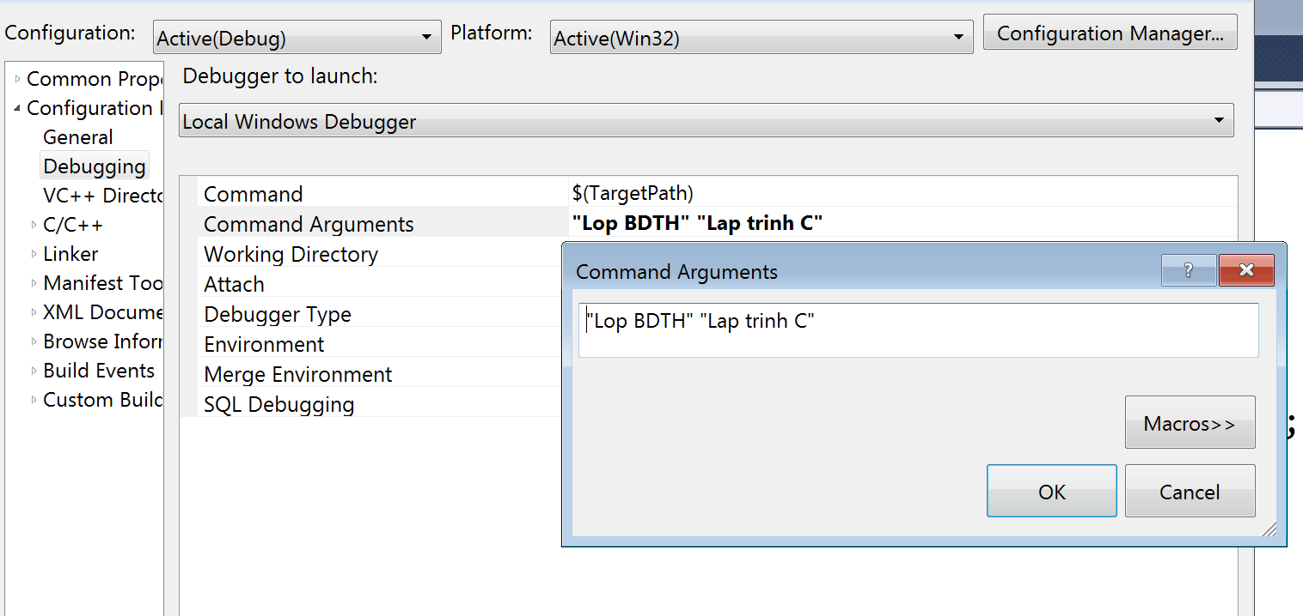
The “main” function and library function
How to pass command line arguments in Visual Studio

Slide 16
The “main” function and library function
Example: Functions in the library <math.h>
(1) Use directive #include <math.h> to tell the compiler to use the library <math.h>
(2) Call the necessary functions. When calling a function, we only need to know
Function name + use of a function
The values to be provided to the function
The return value of the function

Slide 17
The “main” function and library function
Example: Functions in the library <math.h>
Example code:
Function calls
#include <iostream>
#include <iomanip>
#include <math.h>
using namespace std;
int main(int argc, char* argv[]){
cout << setw(10) << "sqrt(25.0)" << "=" << sqrt(25.0) << endl;
cout << setw(10) << "sin(90.0)" << "=" << sin(90.0f*(3.14159/180.0)) << endl;
cout << setw(10) << "cos(0.0)" << "=" <<
cos(90.0f*(3.14159/180.0)) << endl;
cout << endl << endl;
system("pause");
return EXIT_SUCCESS;
}

Slide 18
Using user-defined functions
Consist of two steps
(1) Create a function
Describe a function
Implement a function
(2) Call the function

Slide 19
Using user-defined functions Function definition
Function description, includes:
(1) Return type: in this example it’s int
(2) Function name: in this example it’s “add”
(3) Parameters: are the inputs of the function
This example has
The first parameter: Named “a”, type of int
Second parameter: Named “b”, type of int
Parameter list: Begin with ”(“, end with “)”
Parameters are separated by commas “,”
#include <iostream>
using namespace std;
int add(int a, int b)
{
int c;
c = a + b;
return c;
}
int main(){
cout << "10 + 15 = " << add(10, 15) <<endl;
system("pause");
return EXIT_SUCCESS;
}
Function names and parameter names follow C++ naming rules

Slide 20
Using user-defined functions Function definition
The body of the function:
Including statements that are to be executed together, sequentially. In this example: There are 3 statements in the body of function add.
Use statement return to terminate function execution and return the control to the function called this function → Execute the statement after function call statement.
#include <iostream>
using namespace std;
int add(int a, int b)
{
int c;
c = a + b;
return c;
}
int main(){
cout << "10 + 15 = " << add(10, 15) <<endl;
system("pause");
return EXIT_SUCCESS;
}
The commands in the body of the function must be nested together with a pair of curly braces “{“ and “}”

Slide 21
Using user-defined functions Function call
Function call :
Use the function name and pass values as parameters to the function:
The passing order decides which value will be passed to which parameter.
This example: 10 is passed to a; 15 is passed to b
Must pass enough (No missing, no redundant) all parameters
Invalid calls: add(), add(10), add(10, 20, 30)
#include <iostream>
using namespace std;
int add(int a, int b)
{
int c;
c = a + b;
return c;
}
int main(){
cout << "10 + 15 = " << add(10, 15) <<endl;
system("pause");
return EXIT_SUCCESS;
}
The function defination must appear before the function call to compile without the “undefined identifer” error.

Slide 22
Using user-defined functions Principles of execution when calling a function
When the function call is executed, the execution will do the following tasks
Trace: The next statement of the function call
Copy parameters for the function to be called
Do other system jobs (C++ programmers should not care for now)
Transfer execution control to the called function so that it executes its first statement
The called function execute the other statements
When the called function executes the statement return:
Release all of its local variables
Returns control to the statement following the function call statement in the caller
The caller function releases the passed parameters and executes the next statement after the function call statement

Slide 23
Using user-defined functions Principles of execution when calling a function
Display the actual sequence of execution using the "debug“ tool
Direct illustration
Note: Show Assembly statememts

Slide 24
Organizing source code
int add(int a, int b)
{
int c;
c = a + b;
return c;
}
Function description (header)
Function body
The description should be separated from the whole definition of a function.
Reason:
No need to care about the order of functions in source code.
Reusing functions in a project or multiple projects
Develop library of functions → No need to deliver the actual implementation source code to 3rd-parties (Library buyers)

Slide 25
Organizing source code
#include <iostream>
using namespace std;
int add(int a, int b);
int main(){
cout << "10 + 15 =" << add(10, 15);
cout << endl;
system("pause");
return EXIT_SUCCESS;
}
int add(int a, int b)
{
int c;
c = a + b;
return c;
}
Separate the description of the "add" function and put it before "main" function (before usage).
It is not necessary to place the entire definition of the "add" function before the "main" function

Slide 26
Organizing source code
Put the descriptions into a separate file
Called description files (header): *.h
Can be reused in many other files in the project
Use the directive #if !defined(.) … endif to avoid the "repeat definition" error (redefinition)
Put the implementation section into a separate file
Called implementation file: *.c; *.cpp
Can be reused in many other files in the project
Declaration should use the functions in * .h mentioned above

Slide 27
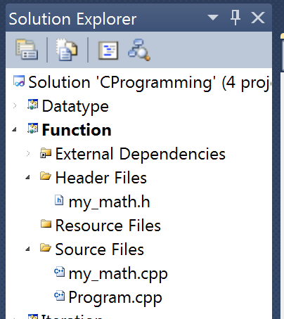
Organizing source code
The file contains the description for the functions, data type, etc. Generally, descriptive sections
The file contains the implementation of "add" function, its declaration uses the description in * .h
The file contains the main function, which call the "add" function.

Slide 28
Organizing source code
dependent
Module
Description of functions
(my_math.h)
dependent
Module
Main program
(program.cpp)
Module
Implementation of functions
(my_math.cpp)
Dependence is expressed by the directive
#include “my_math.h” in the source code

Slide 29
Organizing source code
File: ”my_math.h”
#if !defined(MY_MATH_HEADER)
#define MY_MATH_HEADER
int add(int a, int b);
#endif
MY_MATH_HEADER Is a token (name)
The meaning of the indicator #if:
If in the compilation process, up to the current point, the compiler has not yet seen token (MY_MATH_HEADER) then it will define a new name (MY_MATH_HEADER) And compile the source code in the corresponding block #if
Else, Does not define a new name and does not compile the corresponding block source code if
Description of the add function

Slide 30
Organizing source code
File: ”my_math.h”
#if !defined(MY_MATH_HEADER)
#define MY_MATH_HEADER
int add(int a, int b);
#endif
MY_MATH_HEADER Is a token (name)
Description of the add function
Thanks to the #if ... directive, description of the same function are not repeated many times when used in many different files, including the * .h file.

Slide 31
Organizing source code
File: ”my_math.cpp”
#include "my_math.h"
int add(int a, int b)
{
int c;
c = a + b;
return c;
}
Declare the use of the description in * .h file ("my_math.h")
The implementation of a function (add function)

Slide 32
Organizing source code
File: ”program.cpp”
#include <iostream>
#include "my_math.h"
using namespace std;
int main(){
cout << "10 + 15 =" << add(10, 15)
<< endl;
system("pause");
return EXIT_SUCCESS;
}
Declare the use the descriptions in * .h file ("my_math.h")
Function call (add function)

Slide 33

Organizing source code
Problem: construct functions to calculate a complex number
Analysis:
Need to provide data type for complex numbers: z = x + y*i
Provides functions with this new type
The function that compute the magnitude of the complex number

Slide 34
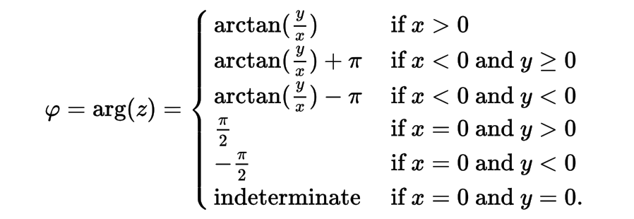
Organizing source code
Problem: construct functions to calculate a complex number
Analysis:
Need to provide data type for complex numbers: z = x + y*i
Provides functions with this new type
The function that compute the magnitude of the complex number
The function that computes the angle of the complex number

Slide 35
Organizing source code
The function that computes the angle of the complex number
Need to define constants
Pi
Constant represents “indeterminate” value
Can be represented by 2 * PI or any value outside the range [-PI, PI].
It is necessary to define macros to support "==“ comparison with real numbers to avoid numerical representation errors

Slide 36
Organizing source code
The function that computes the angle of the complex number
Need to define constants
Pi
Constant represents “indeterminate” value
Can be represented by 2 * PI or any value outside the range [-PI, PI].
It is necessary to define macros to support "==“ comparison with real numbers to avoid numerical representation errors
#define PI 3.14159265
#define UN_DEF_ANGLE (2*PI)
#define EPSILON (1.0E-13)
#define equal(d1, d2) (abs((d1) - (d2)) < EPSILON)
#define RAD_2_DEG (180.0/PI)
#define DEG_2_RAD (PI/180.0)

Slide 37
Organizing source code
Analysis:
Organize source code so that it has the following modules
The header file (complex.h) contains a new type description and describes functions with complex numbers
The source file (complex.cpp) contains the implementation of functions
The source file (program.cpp) contains the function “main” and uses the functions of the complex number

Slide 38
Organizing source code
dependent
Module
Description of functions
(complex.h)
dependent
Module
Main program
(program.cpp)
Module
Implementation of functions
(complex.cpp)
Dependence is expressed by the directive
#include ”complex.h” in the source code

Slide 39
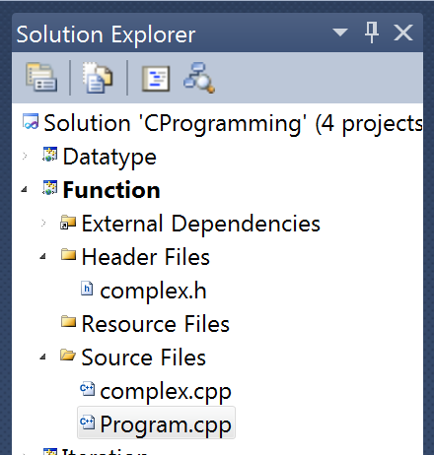
Organizing source code
Files in the project

Slide 40
Organizing source code
File: complex.h
#if !defined(MY_MATH_HEADER)
#define MY_MATH_HEADER
#define PI 3.14159265
#define UN_DEF_ANGLE (2*PI)
#define EPSILON (1.0E-13)
#define equal(d1, d2) (abs((d1) - (d2)) < EPSILON)
#define RAD_2_DEG (180.0/PI)
typedef struct{
double x, y;
} Complex;
double get_magnitude(Complex c);
double get_angle(Complex c);
void print_complex(Complex c);
#endif

Slide 41
Organizing source code
Declare the use of the complex number description
Declare the use of the math functions in math.h
File: complex.cpp
#include "complex.h"
#include <math.h>
#include <iostream>
using namespace std;
double get_magnitude(Complex c){
double mag;
mag = sqrt(c.x*c.x + c.y*c.y);
return mag;
}
Declare the use cout function to print complex numbers to the screen
The definition of the function get_magnitude: Returns the magnitude value of the input (complex number c)

Slide 42
Tổ chức mã nguồn
File: complex.cpp
double get_angle(Complex c){
double angle;
if(c.x > 0){
angle = atan(c.y/c.x);
}
if((c.x < 0) && (c.y >= 0)){
angle = atan(c.y/c.x) + PI;
}
if((c.x < 0) && (c.y < 0)){
angle = atan(c.y/c.x) - PI;
}
if(equal(c.x, 0.0) && (c.y > 0)){
angle = PI/2;
}
if(equal(c.x, 0.0) && (c.y < 0)){
angle = -PI/2;
}
if(equal(c.x, 0.0) && equal(c.y, 0.0)){
angle = UN_DEF_ANGLE;
}
angle *= RAD_2_DEG;
return angle;
}
The function that computes the angle of a complex number

Slide 43
Organizing source code
File: complex.cpp
void print_complex(Complex c){
cout << "[" << c.x << "," << c.y << "]";
}
The function that prints a complex number to the screen

Slide 44
Parameter passing methods

Slide 45
Parameters and arguments
int main(){
cout << "10 + 15 = " << add(10, 15) << endl;
system("pause");
return EXIT_SUCCESS;
}
10: Is the argument of the parameter a
15: Is the argument of the parameter b
int add(int a, int b)
{
int c;
c = a + b;
return c;
}

Slide 46
Parameter passing methods
There are three methods to pass parameter to functions
Pass parameters by value or pass by value
Pass parameters by pointer or pass by pointer
Pass parameters by pointer or pass by reference

Slide 47
Parameter passing methods
The reason why there are two types of passing
Pass by value
Used when we DO NOT ALLOW the called function to change the value of arguments
Pass by reference
Used when we want to ALLOW the called function to change the value of arguments
Or
When you do not want the program to spend too much time preparing the parameters of the called function in runtime (that is, the program HAS TO COPY the value of the arguments to the parameters). For example: copying a large array can take a lot of time -> pass by reference tackles this

Slide 48
Parameter passing methods The difference in syntax
The asterisk (*) indicates which parameters will be passed by address
void swap(int a, int b){
}
a and b will be passed by value
void swap(int *a, int *b){
}
a and b will be passed by pointer

Slide 49
Parameter passing methods Function call: passed by value
#include <iostream>
void swap(int a, int b){
}
int main(){
int x = 10, y = 100;
swap(x, y);
swap(10, 100);
swap(x + 10, y*2);
return EXIT_SUCCESS;
}
a and b will be passed by value
The argument could be: Variable
The argument could be: Constant
The argument could be: expression that has the same type as the parameter type

Slide 50
Parameter passing methods Function call: passed by value
#include <iostream>
using namespace std;
void swap(int a, int b){
int t = a;
a = b;
b = t;
}
int main(){
int x = 10, y = 100;
cout << "Before calling the function swap(x,y)\n";
cout << "x = " << x << "; y = " << y << endl;
swap(x, y);
cout << "After calling the function swap(x,y)\n";
cout << "x = " << x << "; y = " << y << endl;
system("pause");
return EXIT_SUCCESS;
}
The swap function swaps the values of two variables a and b through the temporary variable
Function call: x and y are the corresponding argument for a and b

Slide 51
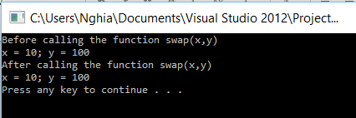
Parameter passing methods Function call: passed by value
The values of x and y stay the same after the swap function (x, y) is done.
Reason: the program has done the following while running
COPY the values of arguments x and y to the memory cells of the parameters a and b, respectively
Function swap(int a, int b) only swaps the values of a and b (not x and y) and ends it
=> The memory cells of x and y are unaffected

Slide 52
Parameter passing methods Function call: passed by value
void swap(int a, int b){
int t = a;
a = b;
b = t;
}
a :
b :
10
100
COPY values
int main(){
int x = 10, y = 100;
swap(x, y);
return EXIT_SUCCESS;
}
x :
10
y :
100
The function call swap(x, y) in function “main” causes the variables a and b to hold the values of x and y respectively: 10 and 100

Slide 53
Parameter passing methods Function call: passed by value
void swap(int a, int b){
int t = a;
a = b;
b = t;
}
a :
b :
10
100
t :
10
int main(){
int x = 10, y = 100;
swap(x, y);
return EXIT_SUCCESS;
}
x :
10
y :
100
int t = a; creates t and make it stores the value of a: 10

Slide 54
Parameter passing methods Function call: passed by value
void swap(int a, int b){
int t = a;
a = b;
b = t;
}
a :
b :
100
100
t :
10
int main(){
int x = 10, y = 100;
swap(x, y);
return EXIT_SUCCESS;
}
x :
10
y :
100
a = b; assigns the value of b to a: 100

Slide 55
Parameter passing methods Function call: passed by value
void swap(int a, int b){
int t = a;
a = b;
b = t;
}
a :
b :
100
10
t :
10
int main(){
int x = 10, y = 100;
swap(x, y);
return EXIT_SUCCESS;
}
x :
10
y :
100
b = t; assigns the value of t to b: 10

Slide 56
Parameter passing methods Function call: passed by value
void swap(int a, int b){
int t = a;
a = b;
b = t;
}
a :
b :
100
10
t :
10
int main(){
int x = 10, y = 100;
swap(x, y);
return EXIT_SUCCESS;
}
x :
10
y :
100
swap(int a, int b) finishing swapping a and b, x and y in main are left untouched. Therefore, when swap ends, values of x and y stay the same

Slide 57
Parameter passing methods Function call: passed by address
#include <stdio.h>
#include <stdlib.h>
void swap(int *a, int *b){
}
int main(){
int x = 10, y = 100;
swap(&x, &y);
swap(10, 100);
swap(x + 10, y*2);
return EXIT_SUCCESS;
}
a and b will be passed by address
Argument: CAN ONLY BE VARIABLES
Argument: CAN’T BE CONSTANT
Argument: CAN’T BE EXPRESSIONS

Slide 58
Parameter passing methods Function call: passed by address
The swap function swaps the values of the arguments passed into a and b
Asterisk operator (*):
a is address → (*a) is the value stored in that memory address
#include <iostream>
using namespace std;
void swap(int *a, int *b){
int t = *a;
*a = *b;
*b = t;
}
int main(){
int x = 10, y = 100;
cout << "Before calling swap(x,y)\n";
cout << "x = " << x << "; y = " << y << endl;
swap(&x, &y);
cout << "After calling swap(x,y)\n";
cout << "x = " << x << "; y = " << y << endl;
system("pause");
return EXIT_SUCCESS;
}
Function call: pass the addresses of x and y into the parameters a and b, respectively.
Ampersand operator (&): used to get the address of a variable

Slide 59

Parameter passing methods Function call: passed by address
The values of x and y are swapped after the function swap(&x, &y) finishes.
Reason: the following tasks were done
The addressed of x and y were COPIED as the values of a and b
The function swap(int *a, int *b) actually swaps the values of x and y through the addresses stored in a and b: using the * operator
Note: when calling swap, we must use the & operator to get the address of a variable

Slide 60
Parameter passing methods Function call: passed by address
void swap(int *a, int *b){
int t = *a;
*a = *b;
*b = t;
}
a :
b :
int main(){
int x = 10, y = 100;
swap(&x, &y);
return EXIT_SUCCESS;
}
x :
10
y :
100
The function call swap(&x, &y) in main allows the variables a and b of swap(int *a, int *b) to store the memory addresses of x and y, respectively

Slide 61
Parameter passing methods Function call: passed by address
void swap(int *a, int *b){
int t = *a;
*a = *b;
*b = t;
}
a :
b :
t :
10
int main(){
int x = 10, y = 100;
swap(&x, &y);
return EXIT_SUCCESS;
}
x :
10
y :
100
int t = *a; creates t and let it take the value stored at the memory address a (i.e. x)
Note: a is an address, but *a is an integer

Slide 62
Parameter passing methods Function call: passed by address
void swap(int *a, int *b){
int t = *a;
*a = *b;
*b = t;
}
a :
b :
t :
10
int main(){
int x = 10, y = 100;
swap(&x, &y);
return EXIT_SUCCESS;
}
x :
100
y :
100
*a = *b; assigns the value stored at memory cell b (100) to the value at memory cell a: this is the same as assigning y to x.

Slide 63
Parameter passing methods Function call: passed by address
void swap(int *a, int *b){
int t = *a;
a = b;
*b = t;
}
a :
b :
t :
10
int main(){
int x = 10, y = 100;
swap(&x, &y);
return EXIT_SUCCESS;
}
x :
10
y :
100
If we write a = b; this will make both a and b shares the address of y → it does not do what we want for this function: swapping values of x and y

Slide 64
Parameter passing methods Function call: passed by address
void swap(int *a, int *b){
int t = *a;
*a = *b;
*b = t;
}
a :
b :
t :
10
int main(){
int x = 10, y = 100;
swap(&x, &y);
return EXIT_SUCCESS;
}
x :
100
y :
10
*b = t; makes the value of t COPIED into the address b; implicitly, the value of t is assigned to y

Slide 65
Parameter passing methods Function call: passed by address
void swap(int *a, int *b){
int t = *a;
*a = *b;
*b = t;
}
a :
b :
t :
10
int main(){
int x = 10, y = 100;
swap(&x, &y);
return EXIT_SUCCESS;
}
x :
100
y :
10
Therefore, when swap ends and the control is returned to main, the values of x and y are 100 and 10 respectively, this means that the swapping was successful.

Slide 66
Function and array, pointer
Note:
Both array and pointer are just cells that store addresses

Slide 67
Function and array, pointer
To use function to process an array, we need to pass
(1) The array
In C++: To pass the array into a function: ⬄ Pass the address of the first element into the function ⬄ Pass the pointer to the first element into the function
C++ always pass arrays by addresses
(2) The number of elements in that array

Slide 68
Function and array, pointer
Example:
Write a function to print every elements of an array
Analysis
(1) We need to pass the array to print it
(2) We need to pass the number of elements in that array

Slide 69
Function and array, pointer
The syntax of an array parameter
void print_array1(int arr[MAX_SIZE], int size){
}
void print_array2(int arr[], int size){
}
void print_array3(int *arr, int size){
}
In all of the three functions above, the first parameters are actually just integer pointers.
The second parameter: size is the number of elements of arr.

Slide 70
Function and array, pointer
Function call:
First argument: a
Pass the address of the first element of a into the function
(passed by address)
Second argument: size
(passed by value)
The syntax of an array parameter
#include <stdio.h>
#include <stdlib.h>
#define MAX_SIZE 100
void print_array1(int arr[MAX_SIZE], int size){}
void print_array2(int arr[], int size){}
void print_array3(int *ptr, int size){}
int main(){
int size = 5;
int a[MAX_SIZE];
for(int i=0; i<size; i++) a[i] = i*i;
print_array1(a, size);
print_array2(a, size);
print_array3(a, size);
return EXIT_SUCCESS;
}

Slide 71
Function and array, pointer
Similarly, if the elements are objects of a pre-defined struct
typedef struct{
char code[10];
char name[50];
float gpa;
} Student;
typedef struct{
double x,y,z;
} Point3D;

Slide 72
Function and array, pointer
Then, the functions that print an array of such type (Student or Point3D) can have the following syntaxes:
void print_array1(Student arr[MAX_SIZE], int size);
void print_array2(Student arr[], int size);
void print_array3(Student *arr, int size);
void print_array1(Point3D arr[MAX_SIZE], int size);
void print_array2(Point3D arr[], int size);
void print_array3(Point3D *arr, int size);

Slide 73
Function and array, pointer Prevent a function from modifying an array
Use the const keyword before the type keyword
void print_array1(const Student arr[MAX_SIZE], int size);
void print_array2(const Student arr[], int size);
void print_array3(const Student *arr, int size);
void print_array1(const Point3D arr[MAX_SIZE], int size);
void print_array2(const Point3D arr[], int size);
void print_array3(const Point3D *arr, int size);

Slide 74
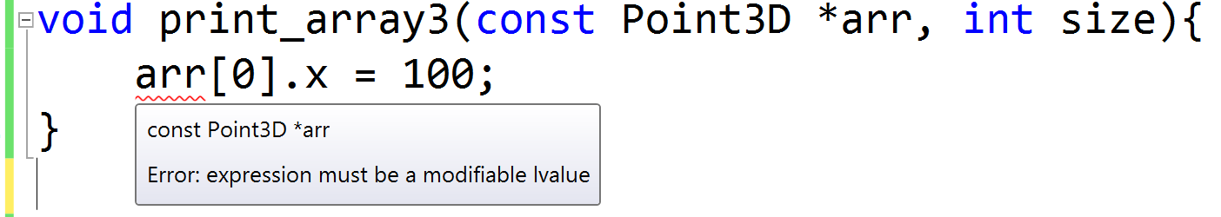
Function and array, pointer Prevent a function from modifying an array
Use the const keyword before the type keyword
If const was used and we still try to modify any element of the array, the compiler will raise an error
Error: “expression must be a modifiable lvalue”
Meaning: arr must not be used in the left-hand side of the assignment expression

Slide 75
Inline function
What is an inline function?
Is a function with the “inline” keyword written before the return type keyword:
inline void print_array1(const Point3D arr[MAX_SIZE], int size);
inline void print_array2(const Point3D arr[], int size);
inline void print_array3(const Point3D *arr, int size);
Inline keyword
Return type

Slide 76
Inline function
The usefulness of inline functions
Non-inline functions:
Each function call needs to perform the following procedures:
Copy parameters
Storing registers
Loading registers
Release parameters
V.v

Slide 77
Inline function
The usefulness of inline function
Inline function
Instead of performing the calling and returning procedures in the case of a normal function, the codes inside the body of an inline function is directly inserted into the caller function
=> Save calling and returning costs
=> But this will increase the size of the executable file (.exe) if the inline function is called multiple times
=> We should only use inline function when we need to optimize the program for speed

Slide 78
Function pointer
What is function pointer
Application of function pointer
Function pointer declaration
Calling a function through a pointer
Define function pointer data type
Passing function pointer
Function pointer array

Slide 79
Function pointer What is function pointer
The pointer to function fx is the address of the first statement to be executed in fx
How to get the address of a function?
The name of a function is also its address

Slide 80
Function pointer Application of function pointer
If there is no function pointer
The function is called through its name in the source code
➔ We need to know the name of the function at compiling time
If function pointer is used
We can call a function through the pointer
➔ There is no need to know the name of the function at compiling time
➔ We only need to know the address of the function at runtime and call it
➔ Our program can be more flexible

Slide 81
Function pointer Application of function pointer
Example: drawing a graph
The drawing function only needs to know: when it pass x as an argument, it will receive the value y from a function. It does not need to know the name of that function and how y is computed at compiling time.
The program creates a function table (an array storing addresses of functions). Function calls can be done through these addresses to calculate y from x.
This function table can be inserted with more functions or accessed in runtime
When the program is running, user will choose a library consisting the evaluating function (evaluate y from x), let the program know the name of the function (in string)
=> The program can draw the graph of functions in that calculations are only known in runtime

Slide 82
Function pointer Application of function pointer
Example: Creating a library in which a function that does some tasks can only be known in the future, depending on each project.
Even-handling functions in libraries used for developing applications in which graphics user interface (GUI) is needed:
Callback function
Example: implement the function table in C++

Slide 83
Function pointer Function pointer declaration
We need to know
The return data type
The list of data types of all parameters
The meaning of the set of functions satisfy the 2 constraints above
Decide the appropriate name for the pointer

Slide 84
Function pointer Function pointer declaration – example
struct Student{
char code[5];
char name[20];
float gpa;
};
Student:
Data type storing information of a student
print_one_row:
A function with void return type, input is a Student
void print_one_row(Student student);
void (*print_ptr1)(Student);
void (*print_ptr2)(Student) = NULL;
void (*print_ptr3)(Student) = print_one_row;
print_ptr1, print_ptr2, print_ptr3:
These are function pointer variables (storing addresses of functions).
We can assign them with a function that (the name of this function is not important):
Has void return type, return nothing
AND has a parameter of type Student

Slide 85
Function pointer Calling a function through a pointer
Source code
#include <stdio.h>
struct Student{
char code[5];
char name[20];
float gpa;
};
void print_one_row(Student student);
void print_one_row(Student student){
cout << student.code << “ ”
<< student.name << “ ”
<< student.gpa << “\n”;
}
Student printing function in a single line

Slide 86
Function pointer Calling a function through a pointer
Main function
int main(){
void (*print_ptr3)(Student) = print_one_row;
Student s = {"001", "Nguyen Thanh An", 9.8f};
print_ptr3(s);
(*print_ptr3)(s);
system("pause");
return EXIT_SUCCESS;
}
Calling a function through the pointer: the function address of a common function name in a common function call
Calling a function through the pointer: using * operator

Slide 87
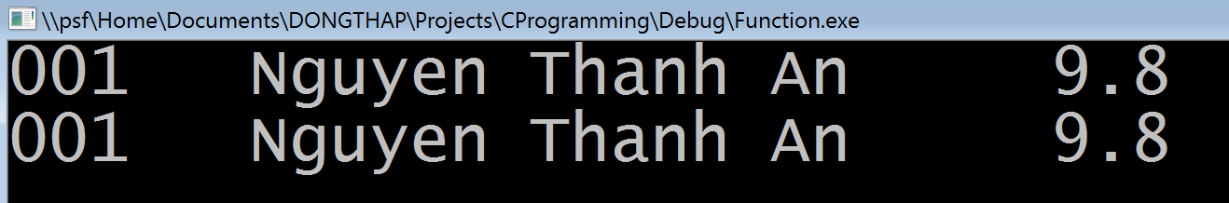
Function pointer Calling a function through a pointer - result
Main function
int main(){
void (*print_ptr3)(Student) = print_one_row;
Student s = {"001", "Nguyen Thanh An", 9.8f};
print_ptr3(s);
(*print_ptr3)(s);
system("pause");
return EXIT_SUCCESS;
}

Slide 88
Function pointer Define function pointer data type
struct Student{
char code[5];
char name[20];
float gpa;
};
typedef void (*PrintStudentPtr)(Student);
The typedef keyword helps shortening variable declaration
PrintStudentPtr: can be used as a new data type now
It is the set of all functions with void return type, accepting a parameter with type Student

Slide 89
Function pointer Define function pointer data type
void (*print_ptr3)(Student) = print_one_row;
PrintStudentPtr print_ptr = print_one_row;
print_ptr3, print_ptr :
These are variable names. They are initialized with the address of the function print_one_row
Thanks to PrintStudentPtr
Declaring print_ptr is the same as declaring any other data type, shorter and easier to read

Slide 90
Function pointer Define function pointer data type
Complete example
#include <stdio.h>
#include <stdlib.h>
struct Student{
char code[5];
char name[20];
float gpa;
};
typedef void (*PrintStudentPtr)(Student);
void print_one_row(Student student);
void print_one_row(Student student){
cout << student.code << “ ”
<< student.name << “ ”
<< student.gpa << “\n”;
}

Slide 91
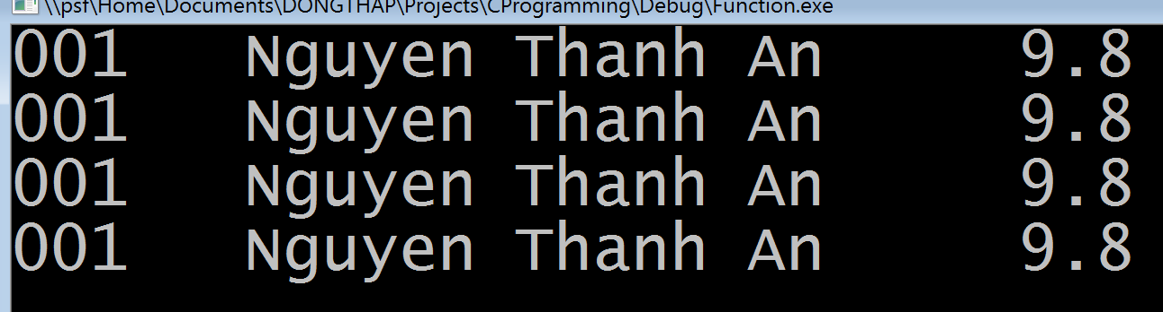
Function pointer Define function pointer data type
Complete example
int main(){
void (*print_ptr3)(Student) = print_one_row;
PrintStudentPtr print_ptr = print_one_row;
Student s = {"001", "Nguyen Thanh An", 9.8f};
print_ptr3(s);
(*print_ptr3)(s);
print_ptr(s);
(*print_ptr)(s);
system("pause");
return EXIT_SUCCESS;
}
Print 4 rows

Slide 92
Function pointer Passing function pointer as a parameter – parameter declaration
void print_list1(Student *list, int size,
PrintStudentPtr print_ptr);
void print_list2(Student *list, int size,
void (*print_ptr)(Student));
Without using function pointer data type
Using function pointer data type with typedef

Slide 93
Function pointer Passing function pointer as a parameter – using parameter
void print_list1(Student *list, int size, PrintStudentPtr print_ptr)
{
for(int i=0; i< size; i++)
print_ptr(list[i]);
}
void print_list2(Student *list, int size, void (*print_ptr)(Student))
{
for(int i=0; i< size; i++)
print_ptr(list[i]);
}
Both of these are just function calls through pointers

Slide 94
Function pointer Passing function pointer as a parameter – using parameter
#include <stdio.h>
#include <stdlib.h>
struct Student{
char code[5];
char name[20];
float gpa;
};
typedef void (*PrintStudentPtr)(Student);
void print_one_row(Student student);
void print_list1(Student *list, int size,
PrintStudentPtr print_ptr);
void print_list2(Student *list, int size,
void (*print_ptr)(Student));

Slide 95
Function pointer Passing function pointer as a parameter – using parameter
int main(){
Student aList[] = {
{"001", "Nguyen Thanh An", 9.8f},
{"002", "Tran Van Binh", 7.5f},
{"003", "Le Tan Cong", 6.7f},
};
PrintStudentPtr func_ptr = print_one_row;
print_list1(aList, 3, func_ptr);
cout << "\n";
print_list2(aList, 3, func_ptr);
cout << "\n\n";
system("pause");
return EXIT_SUCCESS;
}

Slide 96
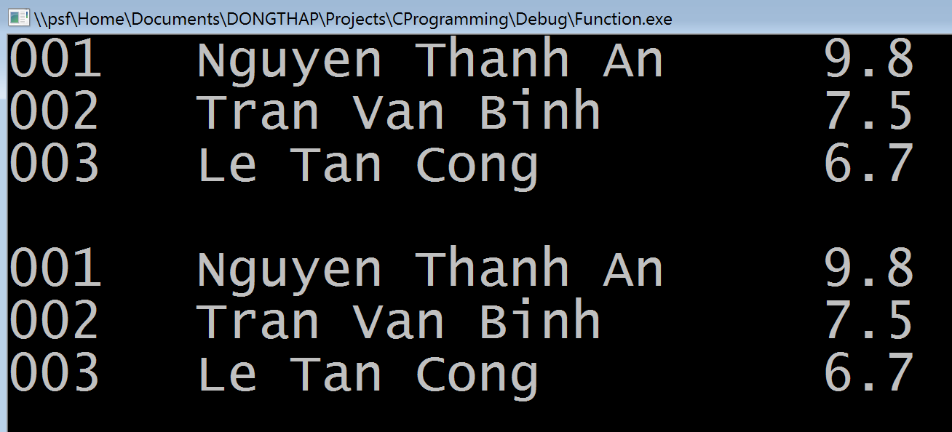
Function pointer Passing function pointer as a parameter – using parameter
Printing result

Slide 97
Function pointer Function pointer array
PrintStudentPtr func_arr_ptr[10];
void (*print_ptr[10])(Student);
Using function pointer data type PrintStudentPtr
Not using function pointer data type PrintStudentPtr
func_arr_ptr and print_ptr are arrays, each has 10 function pointers.
They can be use the same way as arrays of other types

Slide 98
Recursive function
A recursive function is a function that calls itself
Directly:
foo() calls foo() directly inside the body of foo() (itself)
Indirectly:
foo() calls bar() and bar() calls foo(), there can be more intermediate calls but basically some functions will be called again in the call chain

Slide 99
Recursive function
Example
Calculate the sum 1+2+3+ .. + N
Assume that the name of the function is sum: sum(N) will call sum(N-1), sum(N-1) will call sum(N-2), etc.
int sum(int N){
int result;
if(N <= 0) result = 0;
else result = N + sum(N-1);
return result;
}

Slide 100
Recursive function
Example
Calculating the factorial: 1x2x3x …x N
fact(N) will call fact(N-1)
long long fact(int N){
int result;
if(N <= 1) result = 1;
else result = N*fact(N-1);
return result;
}

Slide 101
Recursive function
A requirement of a recursive function:
It must have a stopping condition
Example:
int sum(int N){
...
if(N <= 0) result = 0;
...
}
This will stop the recursion

Slide 102
Recursive function
A requirement of a recursive function:
It must have a stopping condition
Example:
long long fact(int N){
...
if(N <=1) result = 1;
...
}
This will stop the recursion

Slide 103
Recursive function
Requirements of a recursive function
It must have a stopping condition
It must have a function call to itself
Function sum(N) calls sum(N-1)
Function fact(N) calls fact(N-1)

Slide 104
Recursive function
Solving a problem using recursion
The solution of the problem of size N is created from the solutions of problems of smaller sizes.
Example:
To solve the problem of summing N elements:
We must know the solution to the summing N-1 elements problem
Then, how is the solution to the summing N elements problem related to the above result?

Slide 105
Recursive function
Solving a problem using recursion
The solution of the problem of size N is created from the solutions of problems of smaller sizes.
Example:
Solution to the factorial of N
Assume that we know the factorial of N-1
How can we produce the solution to the factorial of N knowing the factorial of N-1?

Slide 106
Recursive function
Solving a problem using recursion
The solution of the problem of size N is created from the solutions of problems of smaller sizes.
Example:
Finding the N-th Fibonacci number
F(1) = 1
F(2) = 1
N >2: F(N) = F(N-1) + F(N-2)
Solution
Assume that F(N-1) and F(N-2) are known
How can the solution of F(N) be made from the above assumption?

Slide 107
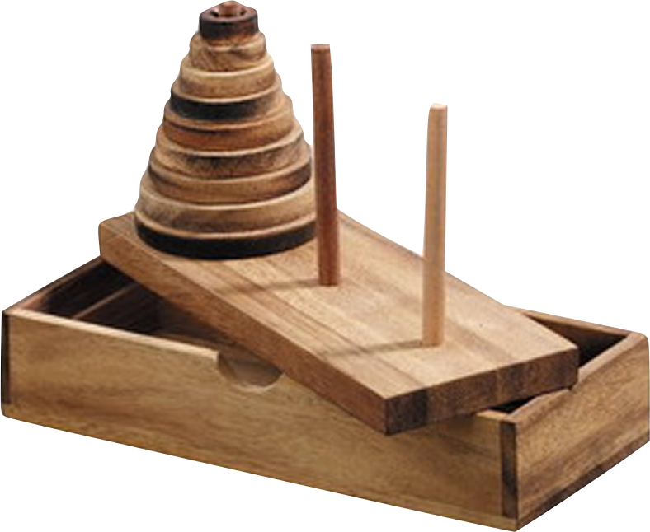
Recursive function
Solving a problem using recursion
Example:
Hanoi tower
Moving a stack of disks from the first rod to the last
The disk above MUST ALWAYS BE SMALLER than the one below

